Slide 1

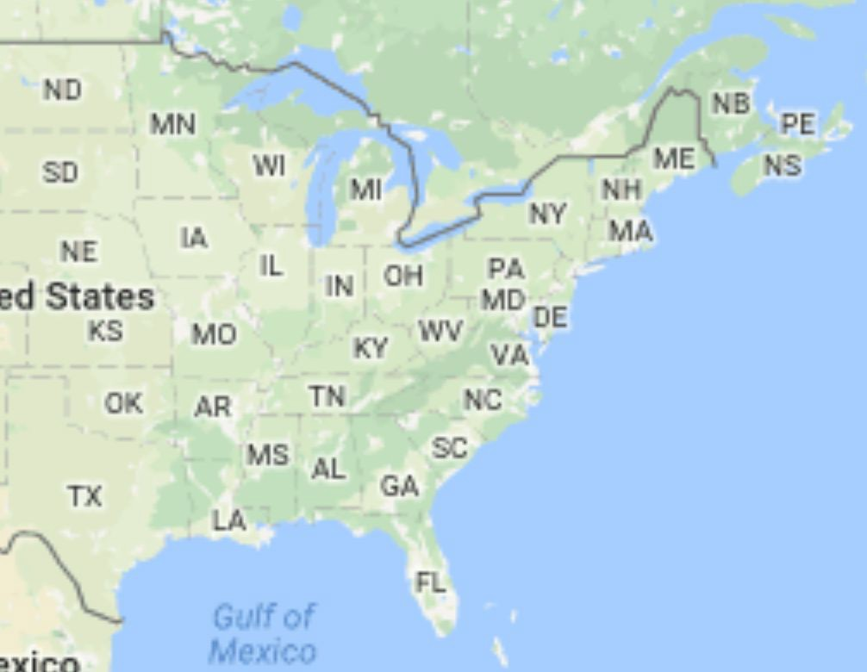


Lauren Blake
@Lauren_E_Blake

Slide 2
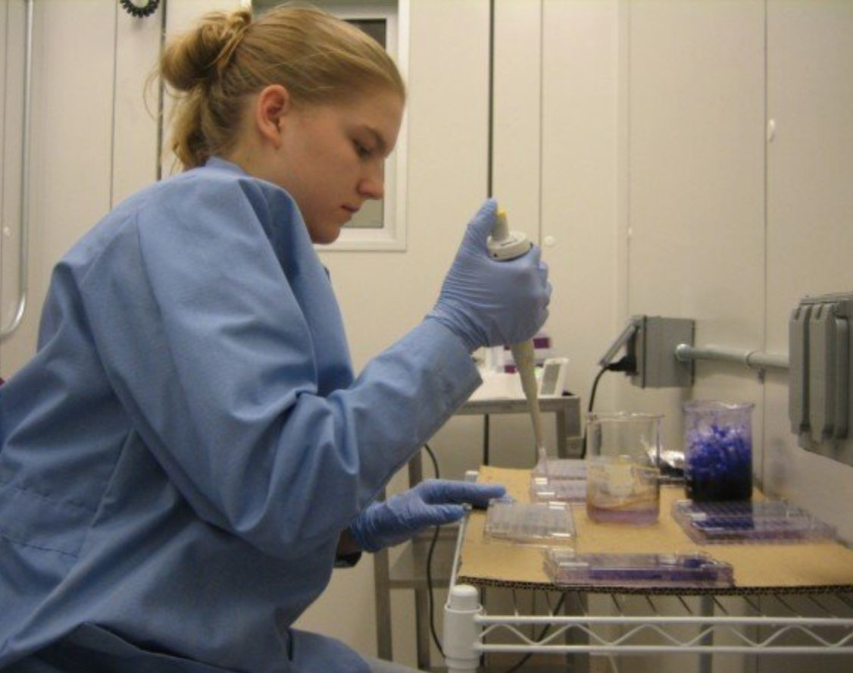



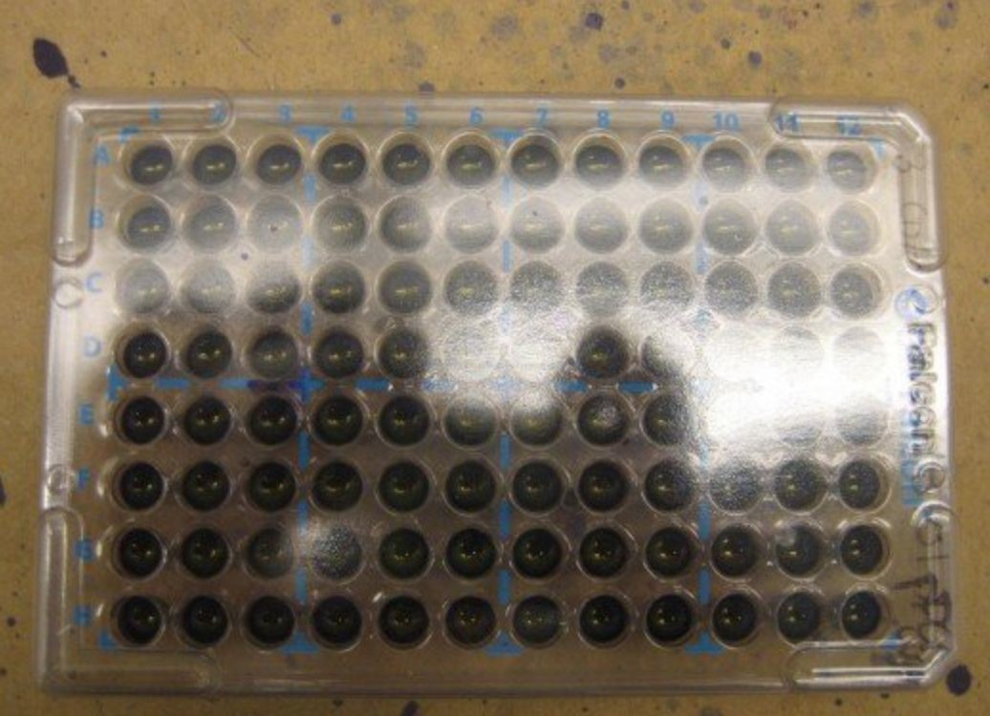
How does the food we eat impact our health?
Ms. Valerie Lechtanski Dr. Terri Camesano

Slide 3



Slide 4
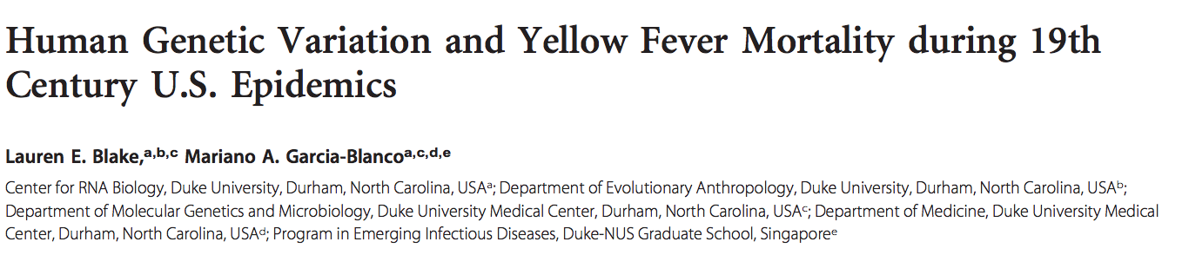
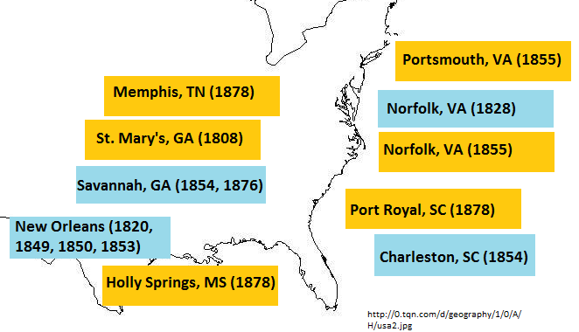
How does genetics influence disease susceptibility and severity?
The yellow fever case mortality rates demonstrate a skew toward populations of European ancestry that is stronger than other infectious diseases/causes of death at the time.

Slide 5
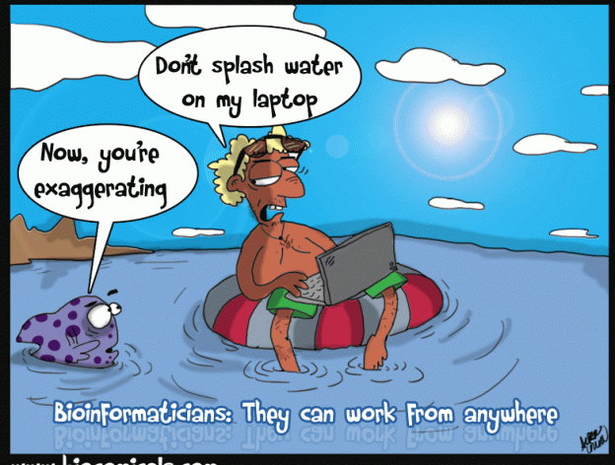

Slide 6


The genetic underpinnings of eating disorders
Eating disorders- Illnesses in which individuals experience severe disturbances in their eating behaviors, and related thoughts and emotions
Anorexia nervosa (AN)- Restriction of energy intake leading to a significantly low body weight; intense fear of gaining weight
Affect people of all genders, ages, races, ethnicities, body shapes and weights, sexual orientations, and socioeconomic statuses

Slide 7
Nutritional rehabilitation for individuals with AN
Hospital admission (60-70% of IBW) Hospital discharge (80-85% IBW)
Outpatient (100% IBW)
Goal: gain 1-2 pounds/week
Goal: gain 2-4 pounds/week
100% of IBW
Example: 5’6’’ woman
IBW: 130 pounds (117-143)
Most people admitted are 60-70% of IBW: 78-91 pounds
Most people are discharged 80-85% of IBW: 104-111 pounds
Ideal body weight: IBW

Slide 8
Nutritional rehabilitation for individuals with AN
Hospital admission (60-70% of IBW) Hospital discharge (80-85% IBW)
Outpatient (100% IBW)
Goal: gain 1-2 pounds/week
Goal: gain 2-4 pounds/week
100% of IBW
Example: 5’6’’ woman
IBW: 130 pounds (117-143)
Most people admitted are 60-70% of IBW: 78-91 pounds
Most people are discharged 80-85% of IBW: 104-111 pounds
35% of patients weight relapse post-discharge
Ideal body weight: IBW

Slide 9
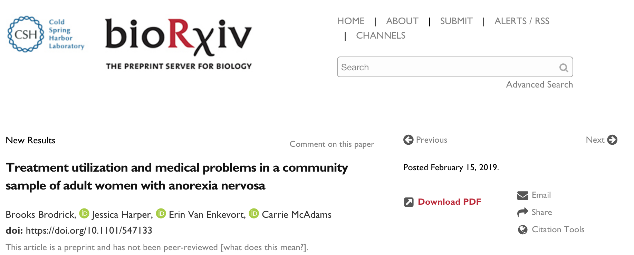
Identifying genes whose expression changes can help distinguish individuals at the highest risk for losing weight post-discharge (weight relapse)
Very challenging statistically

Slide 10
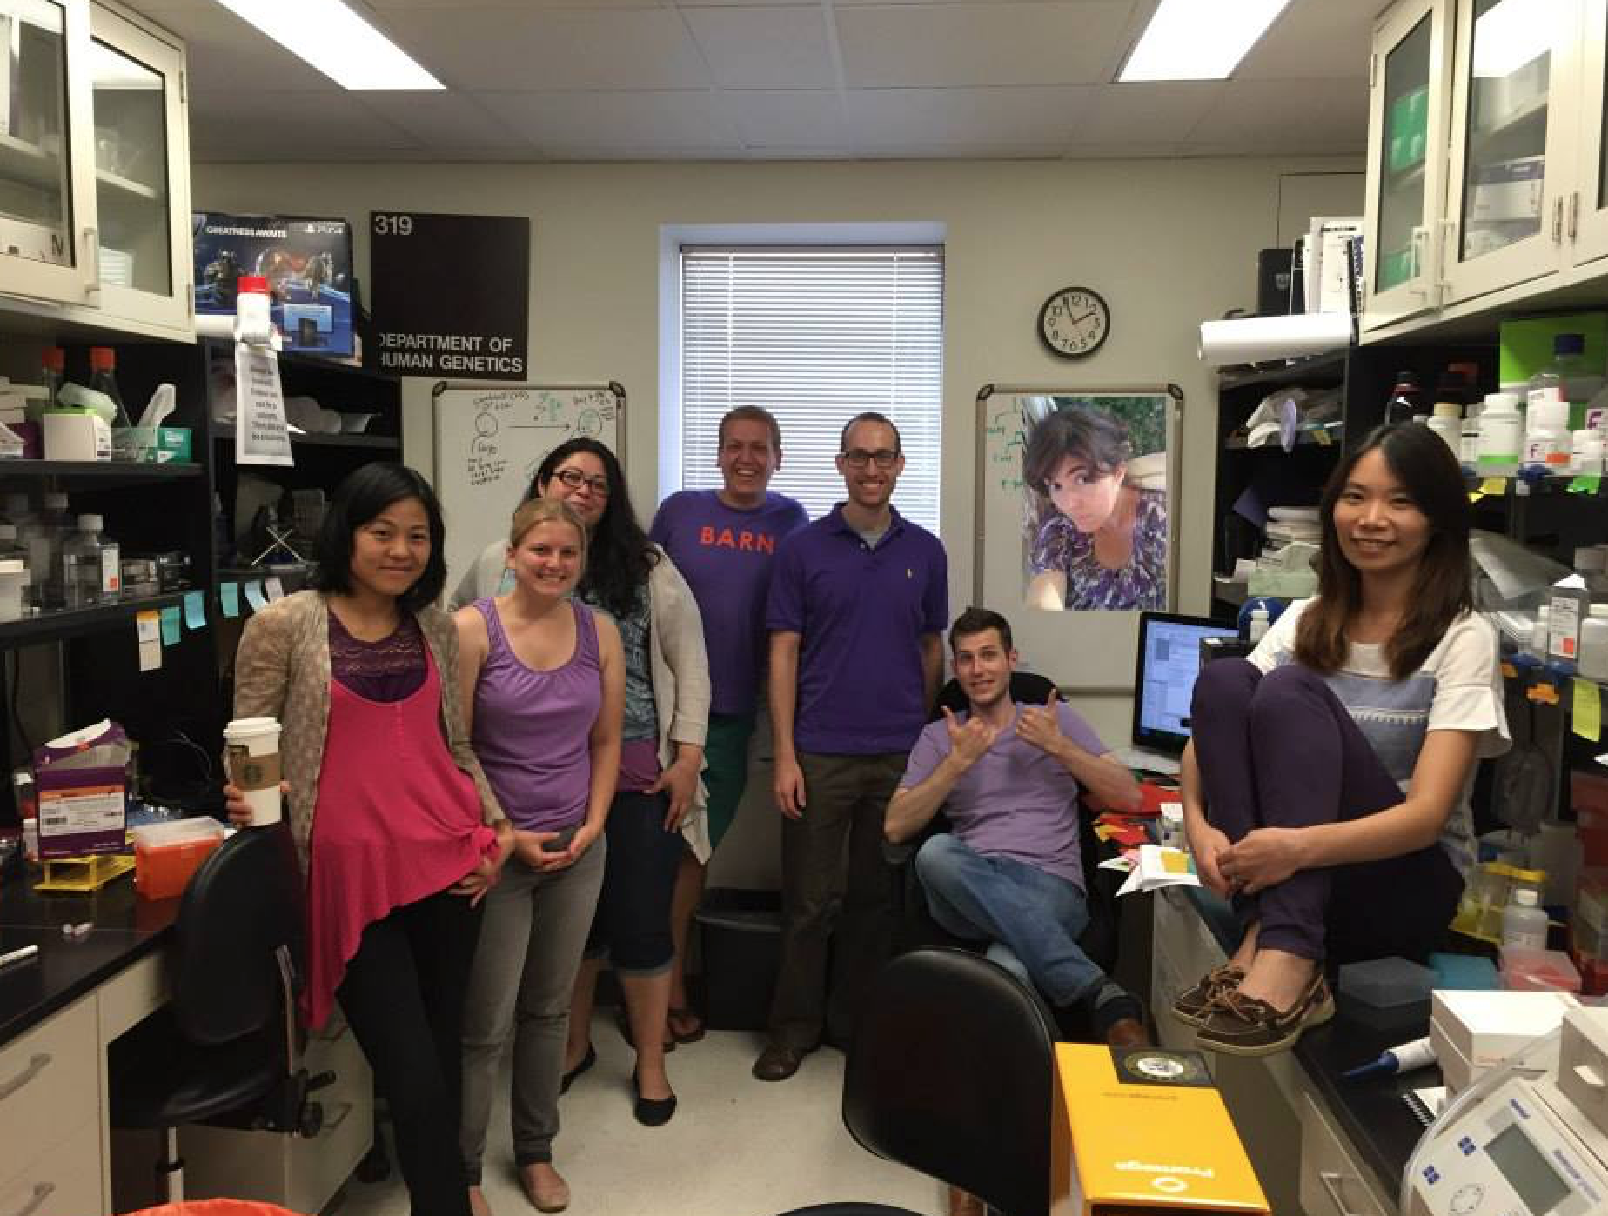
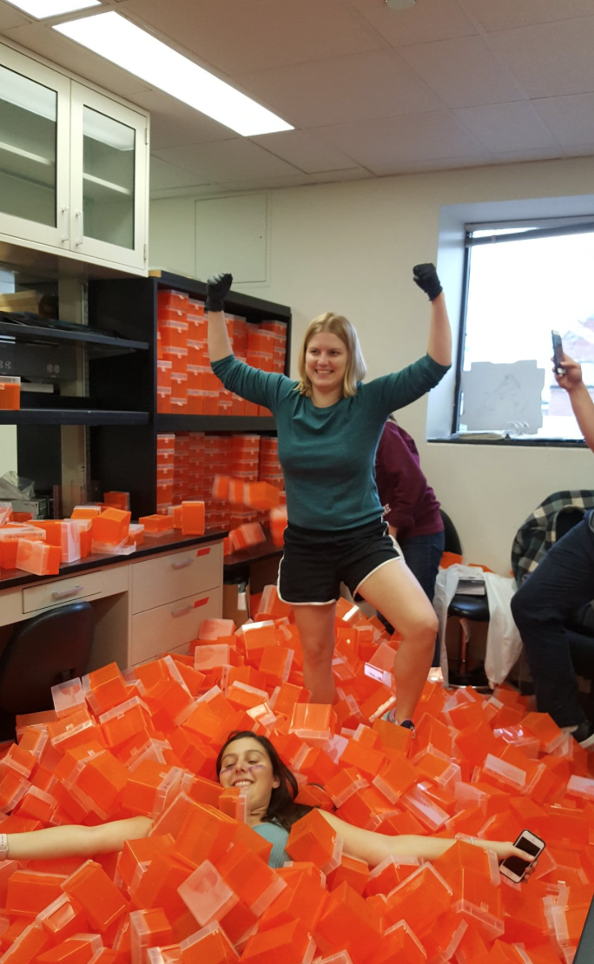

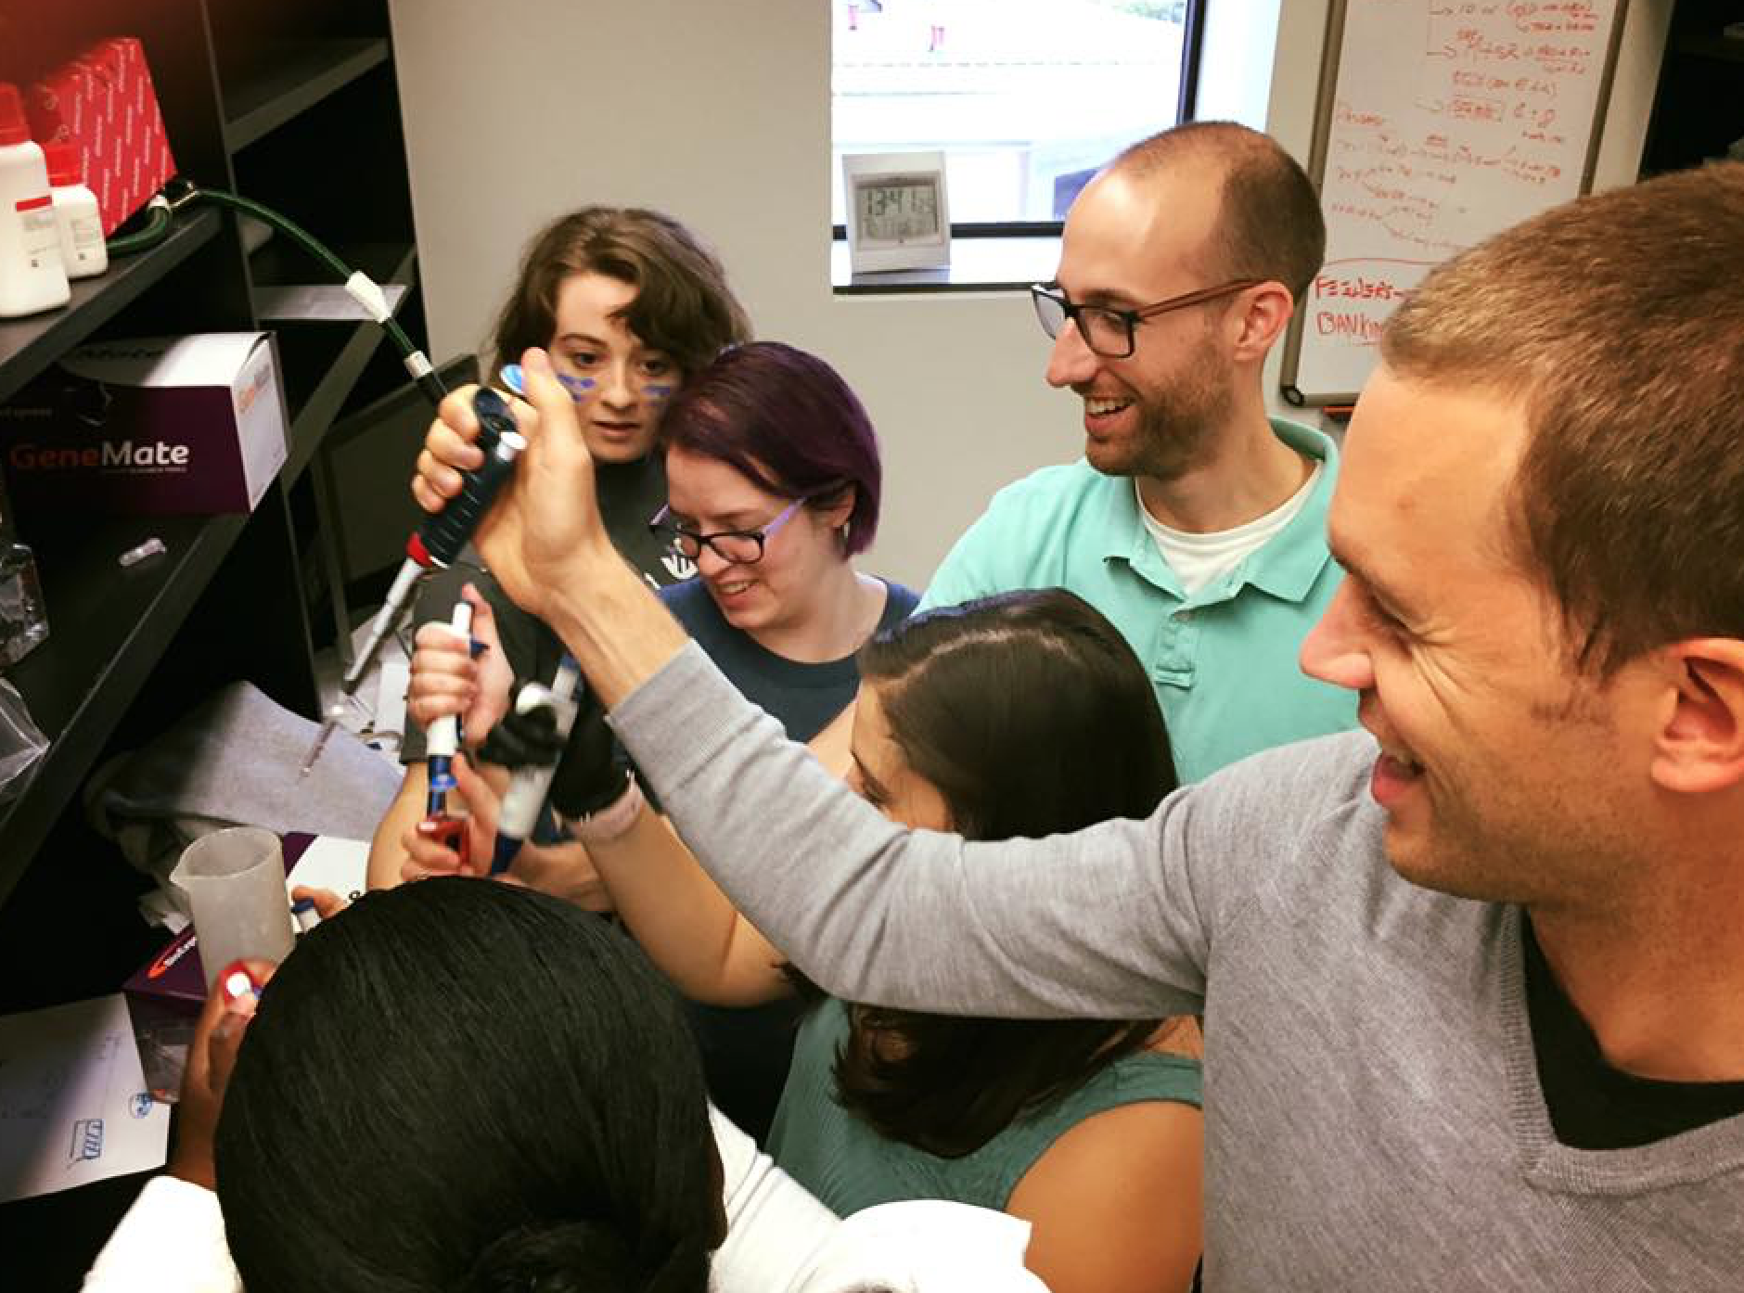
Good news: get help from lots of great labmates/collaborators!

Slide 11
What do eating disorders and NASA have in common?

Slide 12
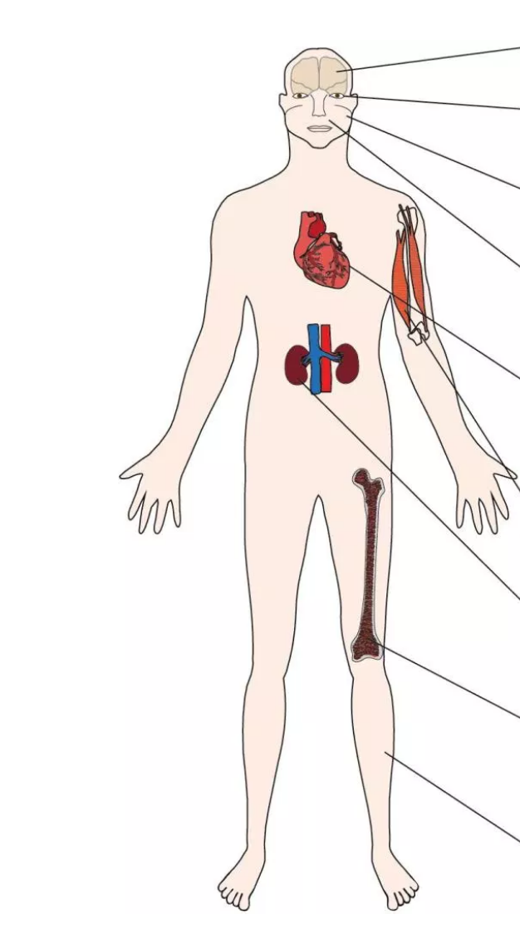
Consequences of space flight (microgravity) on humans

Slide 13
Consequences of space flight (microgravity) on humans overlap some of the medical consequences of anorexia nervosa

Slide 14
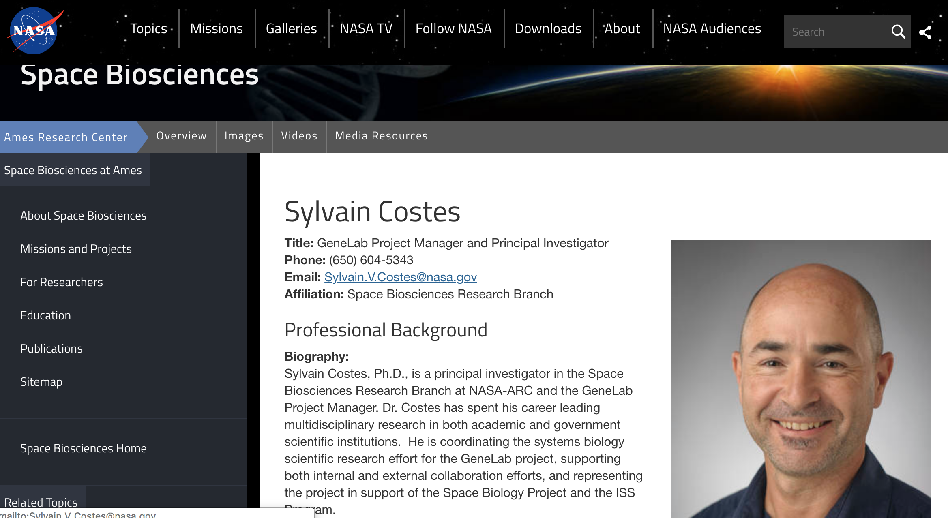
Unique problem common to both groups
Want to develop treatment that helps astronauts/individuals in the hospital increase muscle mass and bone density without burning a lot of calories

Slide 16
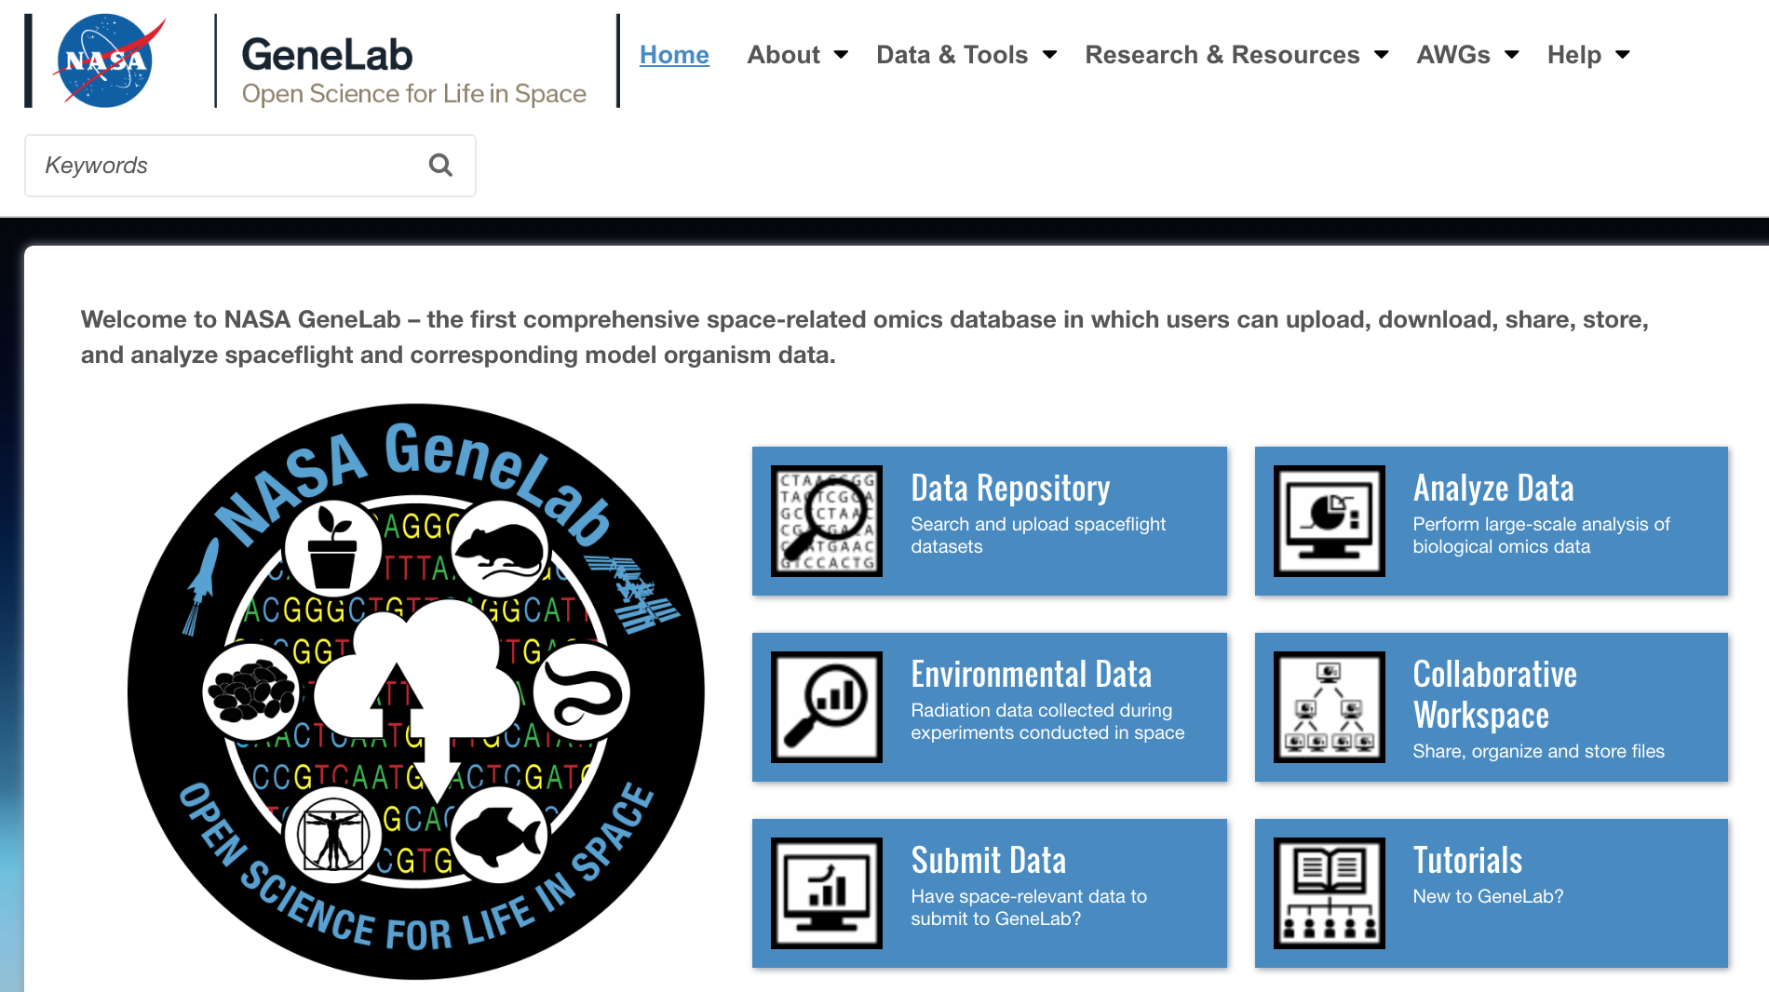

You also have access to NASA data!
https://genelab.nasa.gov/
https://data.nasa.gov/

Slide 17
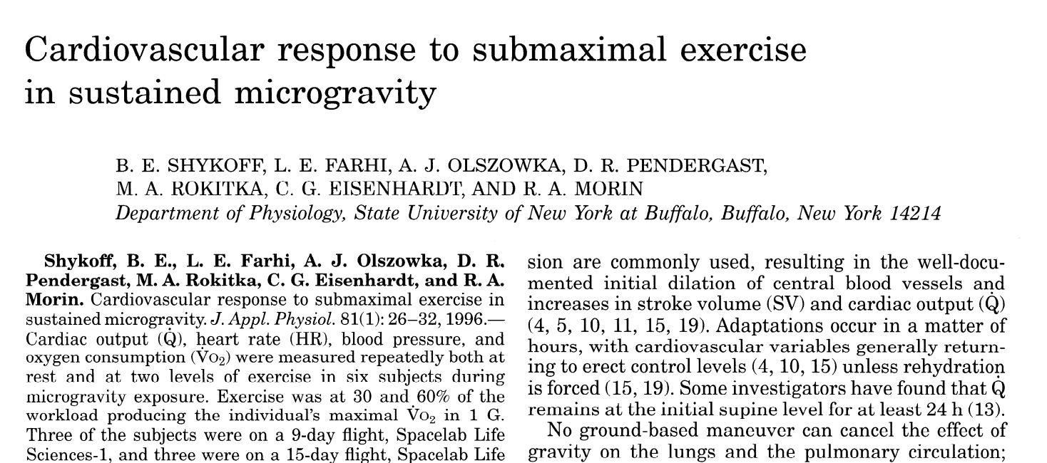
Activity using NASA data: What is the effect of space flight on human hearts?

Slide 18
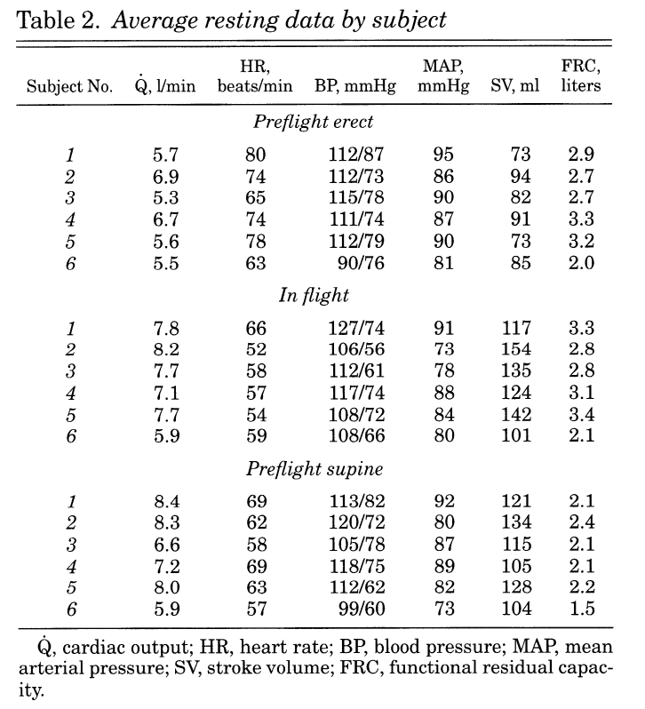
Astronauts that have been in flight for 9 or 15 days
Heart rate (HR)- measure of heart function and cardiovascular fitness
Mean arterial pressure (MAP)- average pressure in a patient’s arteries during one cardiac cycle
Stroke volume (SV)- volume of blood pumped from the left ventricle per beat.
Functional residual capacity (FRC)- volume of air present in the lungs at the end of passive expiration.
Cardiac output (Q)- is the product of the heart rate (HR), or the number of heart beats per minute (bpm), and the stroke volume (SV)

